Slide 1
Flight Price Webscraping & Prediction
In this task we need to create dataset of flight price using webscraping & then we need to perform EDA & model building to observe which factor is affecting the prices of flight & how much each factor is affecting the price.

Slide 2
Steps taken before EDA was performed
Created the dataset using webscraping
Imported necessary libraries for task to be completed
Loaded dataset on jupyter notebook wusing pandas library
Cleaned the target variable & make it refined to make prediction on
Checked dimension of dataset which was showing that dataset contains 1568 rows & 8 columns
Checked description of dataset which gives information of mean, min value, max value, etc of every column in dataset which contains continuous data in it. As we observe we get to know that only target variable was containing continuous data
Checked the presence of null values in the dataset & there were no null values present in it.

Slide 3
Exploratory Data Analysis

Slide 4
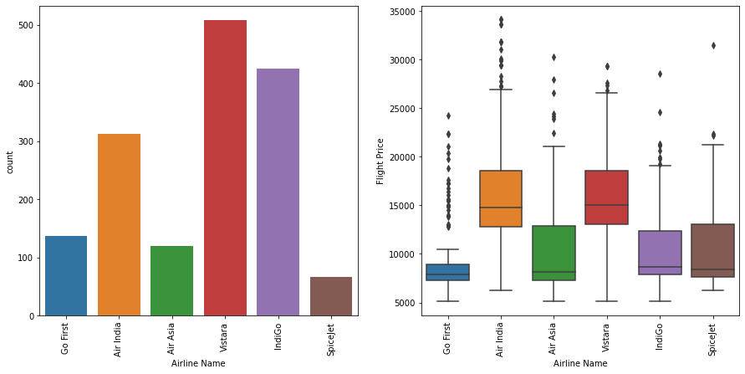
1. Airline Name
Checked unique values of the column.
From visualization we concluded that most passengers are traveling from Vistara airlines & outliers of Flight Price are present in every category of Airline Name.

Slide 5
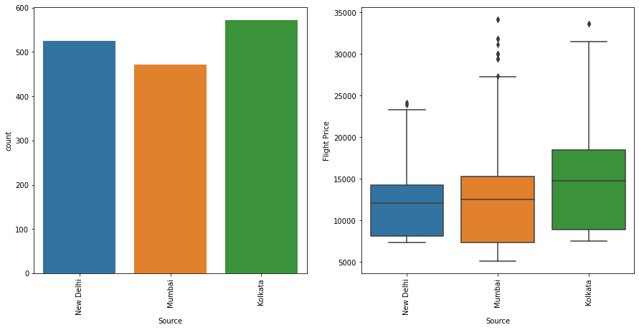
2. Source
Checked unique values of the column.
From visualization we get to know that most passengers boarding the flights are from Kolkata city & outliers of Flight Price are present in every category of Source.

Slide 6
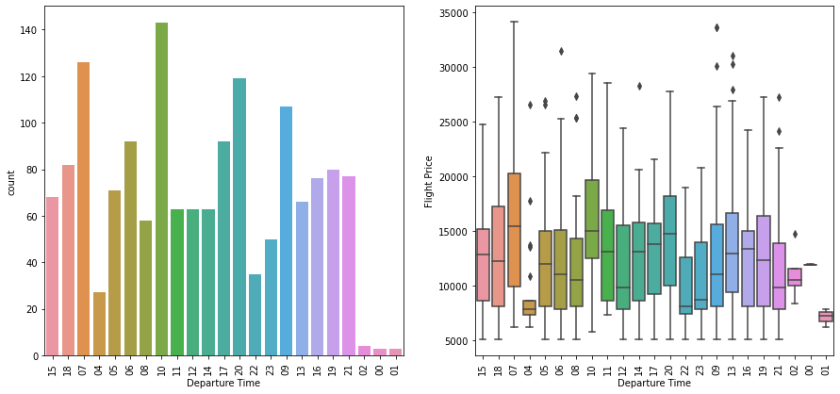
3. Departure Time
Checked unique values of the column.
Made data more refined to use it for visualization.
From visualization we concluded that most passenger’s flight departure time is category 10 of Departure Time & outliers of Flight Price are present in 9 categories out of total 24 categories of Departure Time.

Slide 7
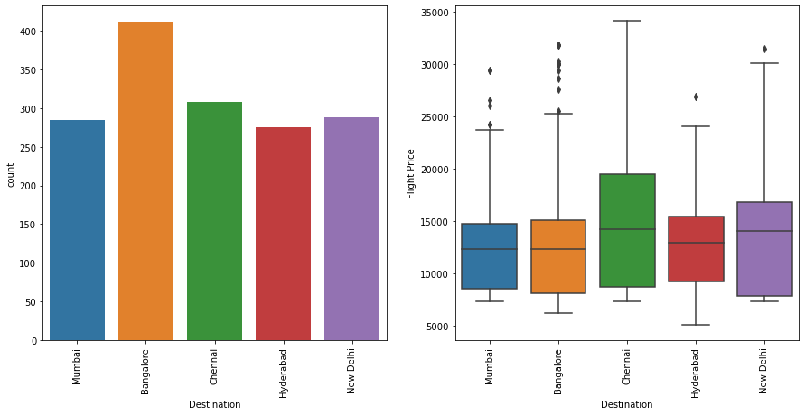
4. Destination
Checked unique values of the column.
From visualization we concluded that most passengers are traveling to Bangalore city & outliers of Flight Price are present in 4 categories out of total 5 categories of Destination.

Slide 8
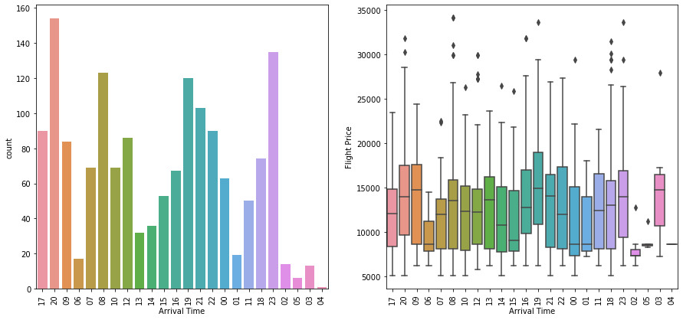
5. Arrival Time
Checked unique values of the column.
Made data more refined to use it for visualization.
From visualization we concluded that most flights arrival time is category 20 of Arrival Time & outliers of Flight Price are present in 15 categories out of total 24 categories of Arrival Time.

Slide 9
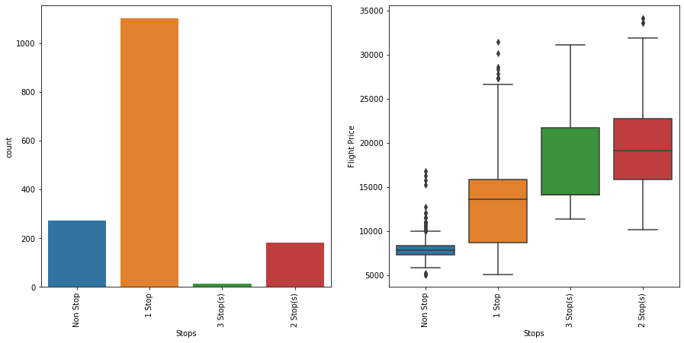
6. Stops
Checked unique values of the column.
From visualization we concluded that most flights flying are having 1 stop in between & outliers of Flight Price are present in 3 categories out of total 4 categories of Stops.

Slide 10
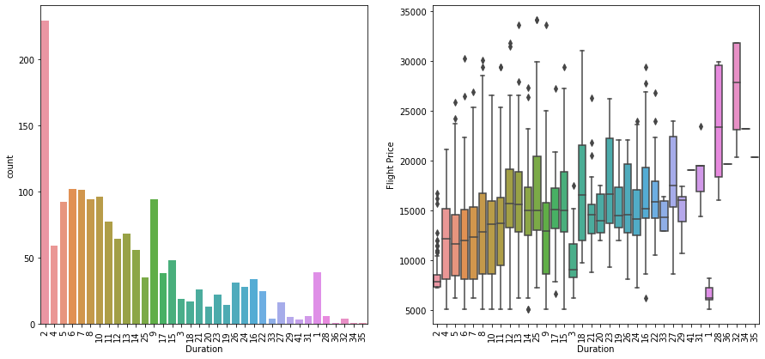
7. Duration
Checked unique values of the column.
Made data refined to use it for visualization.
From visualization we concluded that most flights duration are of 2 hours & outliers of Flight Price are present in 19 categories out of total 36 categories of Duration.

Slide 11
Plotting Heatmap
Plotted Heatmap to check correlation of every column with target column.
We concluded that target column has high positive correlation with following ( Source, Arrival Time, Stops, Duration)
After observing all the columns we decided to drop Destination column to lower the multi-collinearity.

Slide 12
Splitting & scaling data
Splitted the original dataset into X & y in which y contains target column & X contains other columns.
Then we splitted X & y data into training set & testing set.
Then we scaled both X_train & X_test set using Standard scalar to remove outliers if present in dataset

Slide 13
Applying GridSearchCV
We chose 7 regression models (Linear Regression Model, Decision Tree Regression Model, Random Forest Regression Model, Bagging Regression Model, AdaBooster Regression Model, GradientBooster Regression Model & Support Vector Regression Model) to check performance of them on dataset to find out the best suited model for the dataset.
Then one by one we applied GridSearchCV on each model to find best hyper parameter tuning while model is working on the dataset.
After applying GridSearchCV on every model we concluded that out of all models GradientBooster Regression Model is giving the best test r2_score for dataset which is 0.6912 with hyper parameter combination (learning_rate : 0.1, max_depth : 4, min_samples_leaf : 3)

Slide 14
Applying Model on dataset
Chose GradientBooster Regression Model & made it ready by tuning hyper parameter.
After tuning hyper parameter applied model on dataset to make prediction.
After making prediction we made the dataframe showing predicted values & actual values.
Then we applied various metrices on model to check its performance which were r2_score, mean_squared_error score, mean_absolute_error score.
After looking the scores of every metrices we concluded that model is performing quite well on dataset.
After making the conclusion we saved the model using pickle library.

Slide 15
THE END

